Slide 1



Clustering

Slide 2



Trainer Bio
Experience :
Data Scientist at Jabar Digital Service
Data Science Tutor at Shift Academy
Business Intelligence Analyst at Jabar Digital Service
Owner and Consultant at Barz Data Consultant
Data Scientist at IYKRA
Data Analyst at BAPPEDA Sukoharjo
Data Analyst at PT. Arah Environmental
www.linkedin.com/in/akbar-maulana/
akbar.maulana2298@gmail.com

Slide 3
Introduction to Clustering
6

Slide 4
What is Clustering?
Finding groups of objects such that the objects in a group will be similar (or related) to one another and different from (or unrelated to) the objects in other groups.
Inter-cluster distances are maximized
Intra-cluster distances are minimized

Slide 5
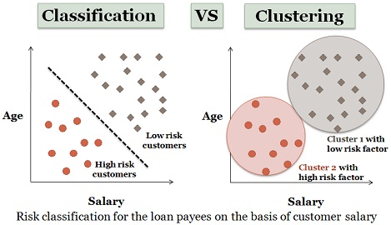
Different Between Classification and Clustering

Slide 6
Clustering Algorithm
K-Means Clustering
K-Medoids Clustering
Hierarchical Clustering
Density-based Clustering
Fuzzy Clustering
Biclustering
etc

Slide 7
Apllication
Customer Segmentation
Fraud/Criminal Activity Identification
etc

Slide 8
K-Means Clustering
7

Slide 9
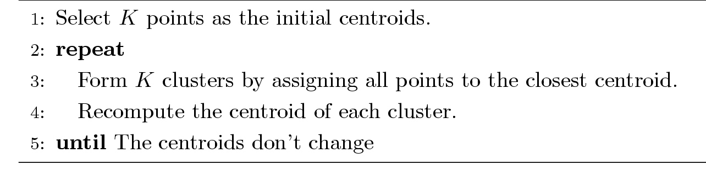
K-Means Clustering
Number of clusters, K, must be specified
Each cluster is associated with a centroid (center point)
Each point is assigned to the cluster with the closest centroid
The basic algorithm is very simple

Slide 10
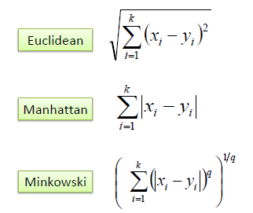
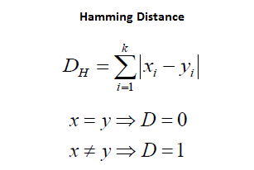
Jarak

Slide 11
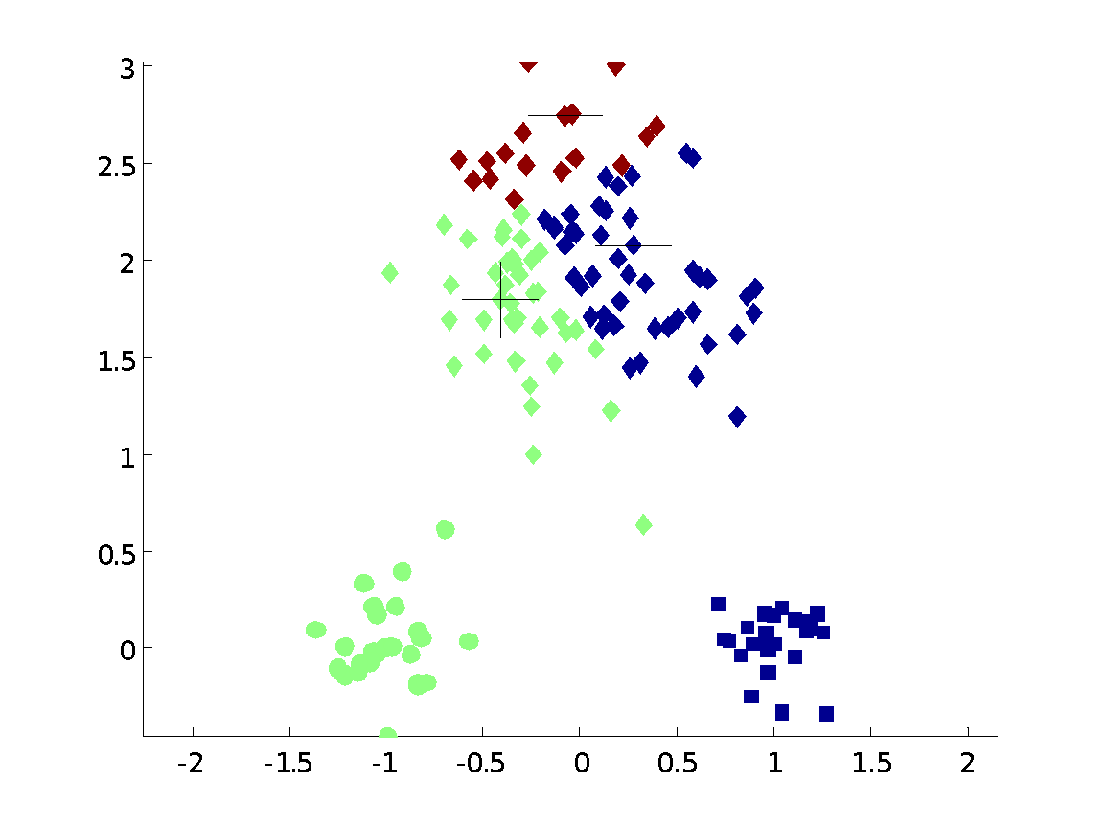
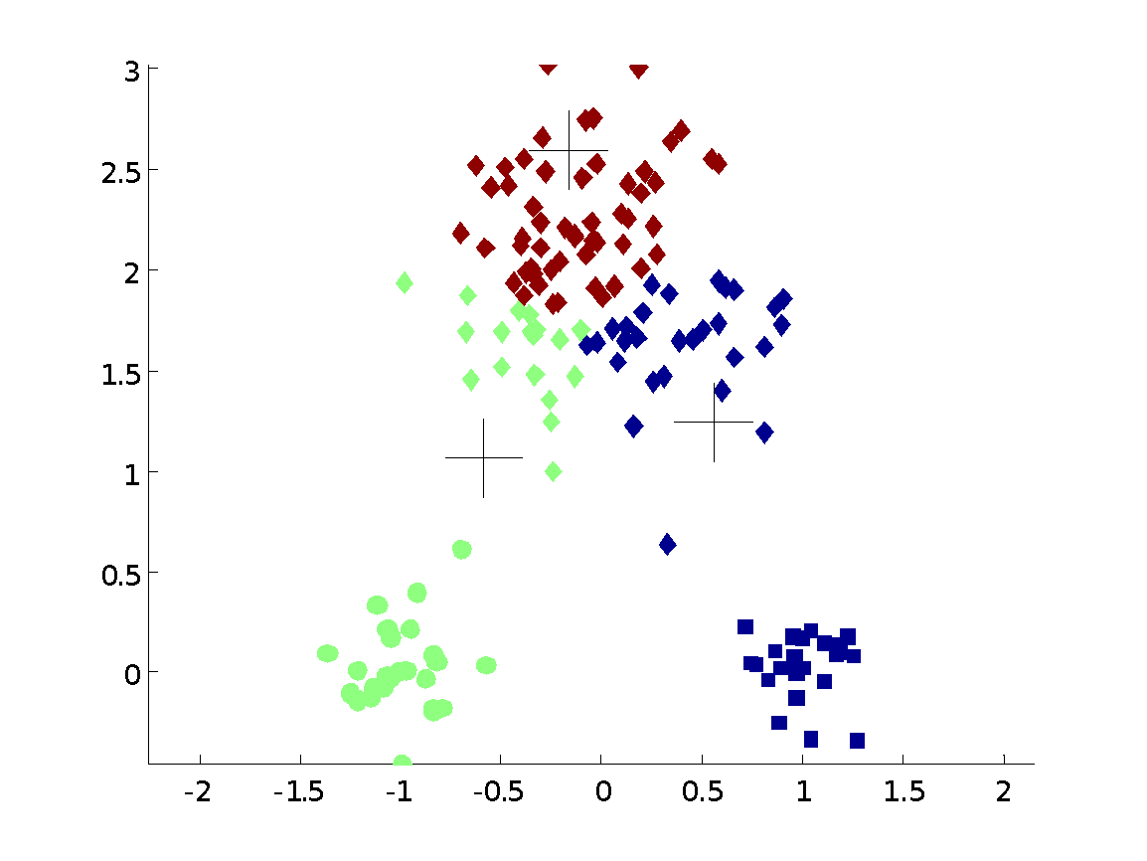
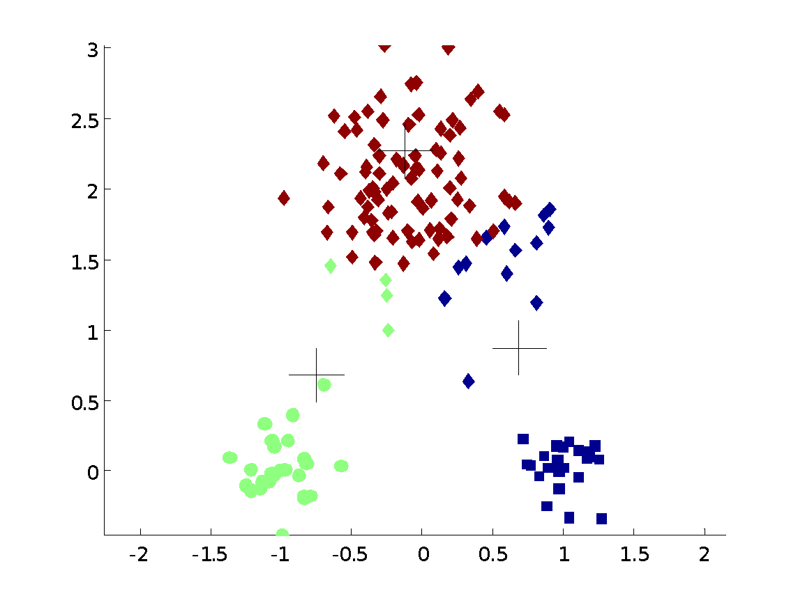
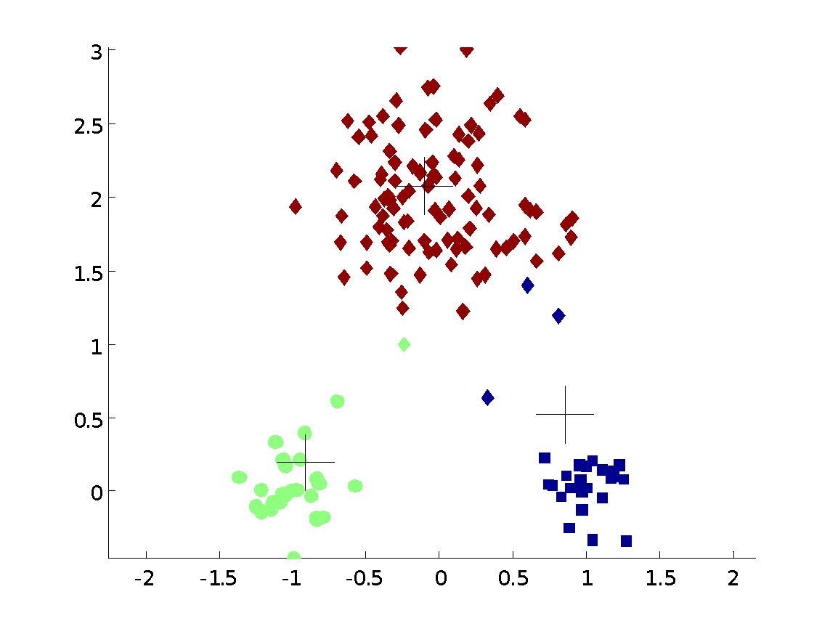


Example

Slide 12
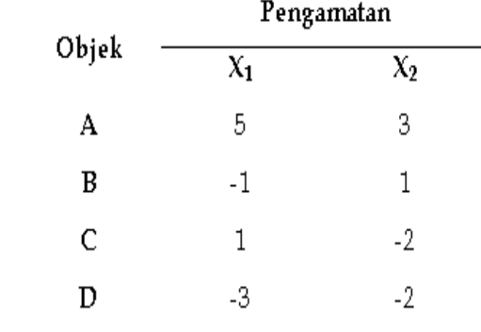
Contoh k-means
Misalkan ada dua variabel X1 dan X2 yang tiap objeknya diberi nama A, B, C dan D. Datanya sebagai berikut:

Slide 13
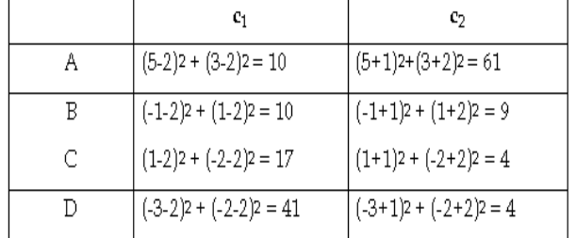
Contoh k-means
Dikelompokkan ke dalam 2 kelompok.
Centroid dipilih secara acak : c1 = (2, 2) dan c2 = (-1, -2).
Jarak yang digunakan jarak Euclidian. Memasukkan objek ke gerombol berpatokan pada jarak terdekat Diperoleh matriks jarak sbb :

Slide 14
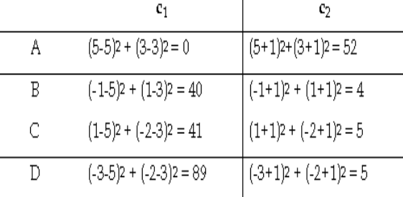
Contoh k-means
Hitung centroid baru, rataan dari vektor masing-masing unsur.
c1 = (5, 3)
c2 = [(-1, 1) + (1, -2) + (-3, -2)]/3 = (-1, -1)
Diperoleh matriks yang sbb :

Slide 15
Contoh k-means
Hitung centroid baru, rataan dari vektor masing-masing unsur.
c1 = (5, 3)
c2 = [(-1, 1) + (1, -2) + (-3, -2)]/3 = (-1, -1)
Diperoleh matriks yang sbb :
Diperoleh 2 cluster : C1 = {A} dan C2 = {B, C, D}.

Slide 16
Limitations of K-means
K-means has problems when clusters are of differing
Sizes
Densities
Non-globular shapes
K-means has problems when the data contains outliers.

Slide 17
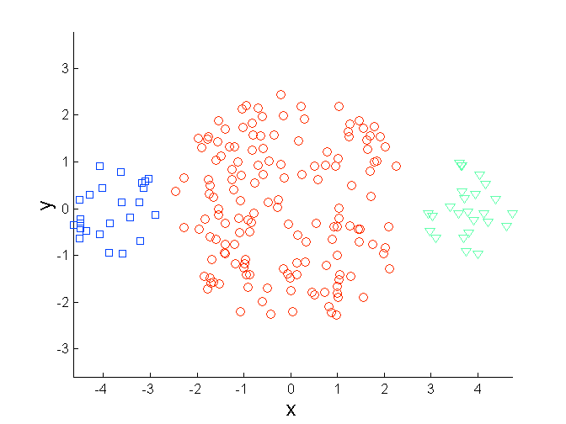
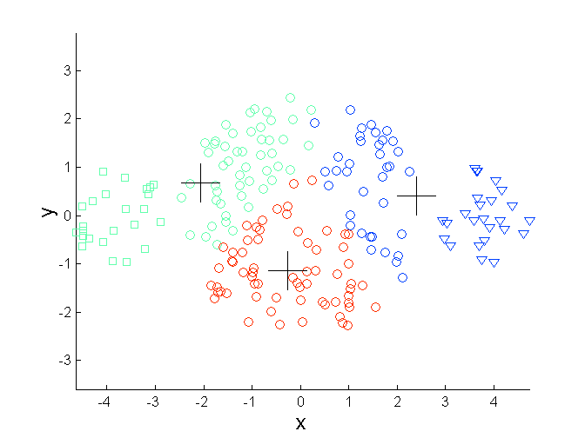
Limitations of K-means: Different Size
Original Points
K-means (3 Clusters)

Slide 18
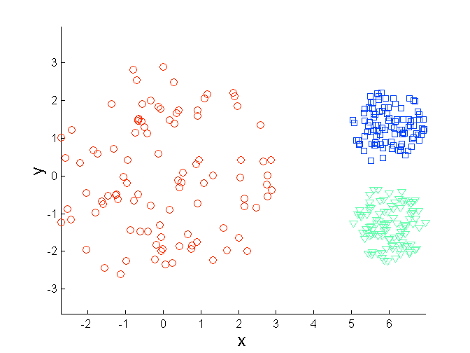
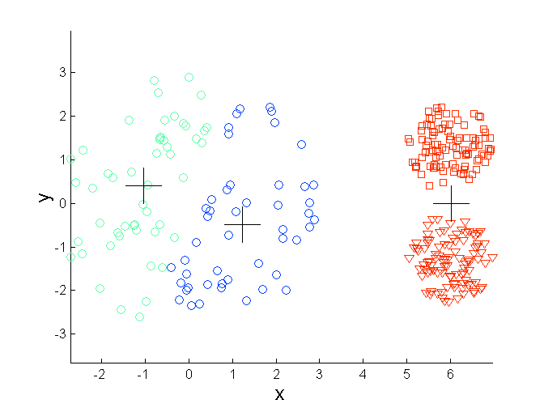
Limitations of K-means: Differing Density
Original Points
K-means (3 Clusters)

Slide 19
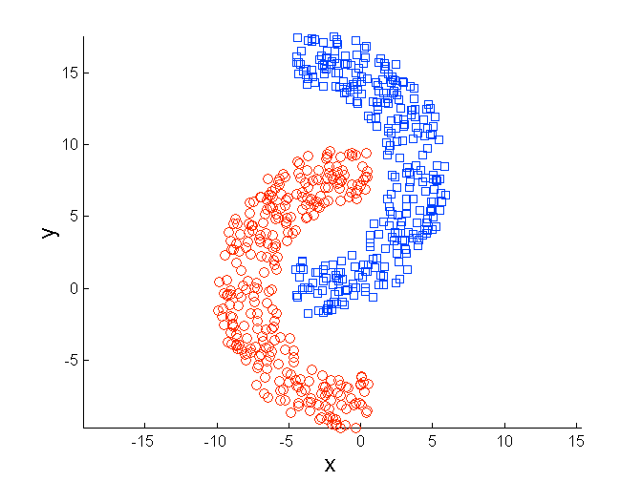
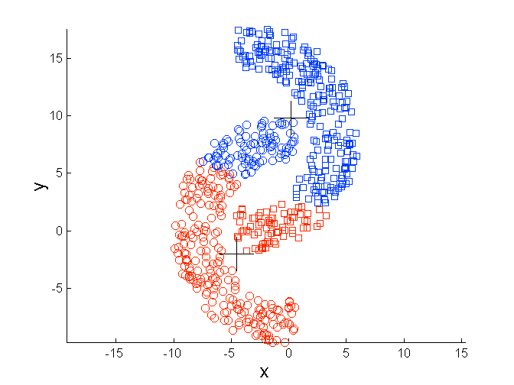
Limitations of K-means: Non-globular Shapes
Original Points
K-means (3 Clusters)

Slide 20
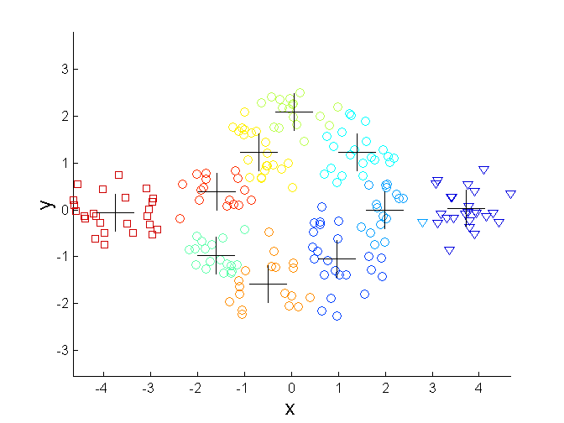
Overcoming K-means Limitations
One solution is to use many clusters.
Find parts of clusters, but need to put together.
Original Points
K-means (3 Clusters)

Slide 21
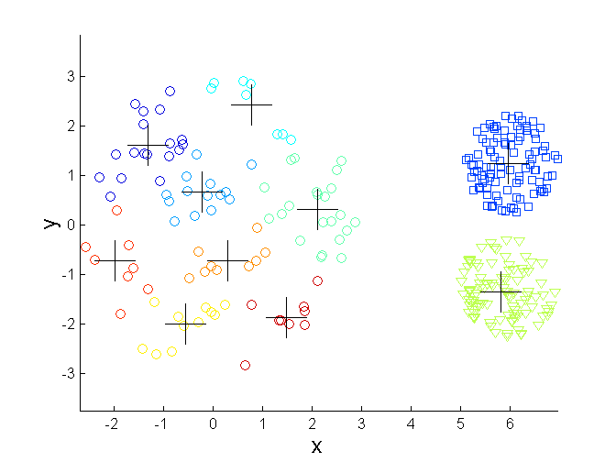
Overcoming K-means Limitations
Original Points
K-means (3 Clusters)

Slide 22
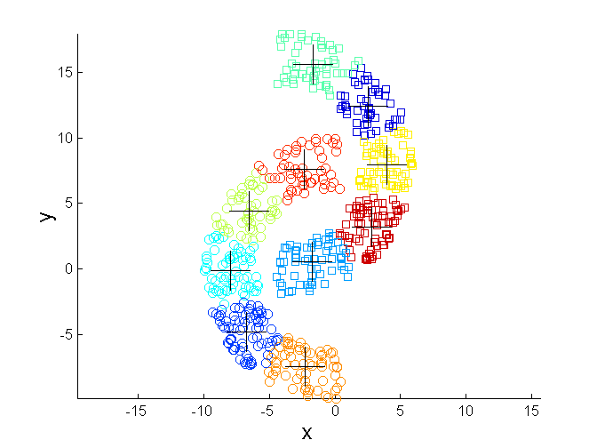
Overcoming K-means Limitations
Original Points
K-means (3 Clusters)

Slide 23
Solutions to Initial Centroids Problem
Multiple runs
Helps, but probability is not on your side
Select more than k initial centroids and then select among these initial centroids
Select most widely separated

Slide 24
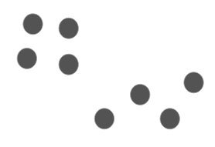
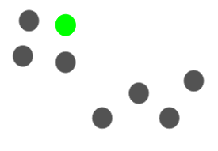
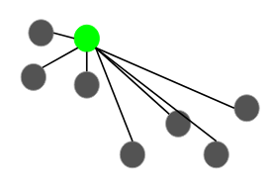
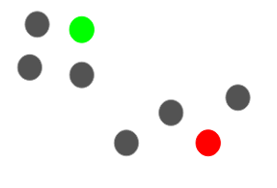
K-means ++

Slide 25
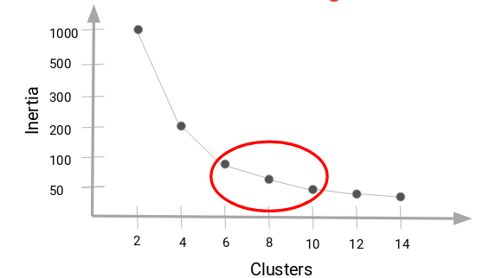
How to Choose the Right Number of Clusters

Slide 26
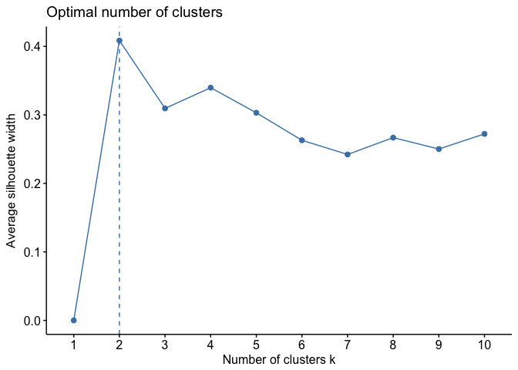
How to Choose the Right Number of Clusters

Slide 27
Pros
Relatively simple to implement
Scales to large data sets
Guarantees convergence
Can warm-start the positions of centroids

Slide 28
Cons
Choosing k manually
Being dependent on initial values
Clustering data of varying sizes and density
Clustering outliers
Scaling with number of dimensions

Slide 29
Hierarchical Clustering
8

Slide 30
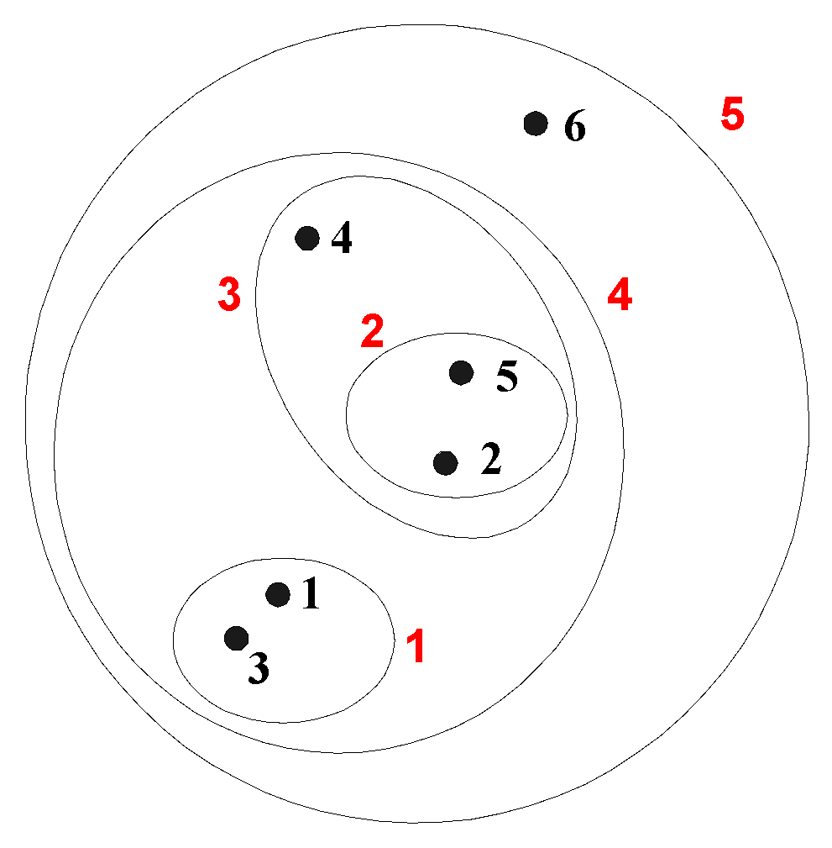
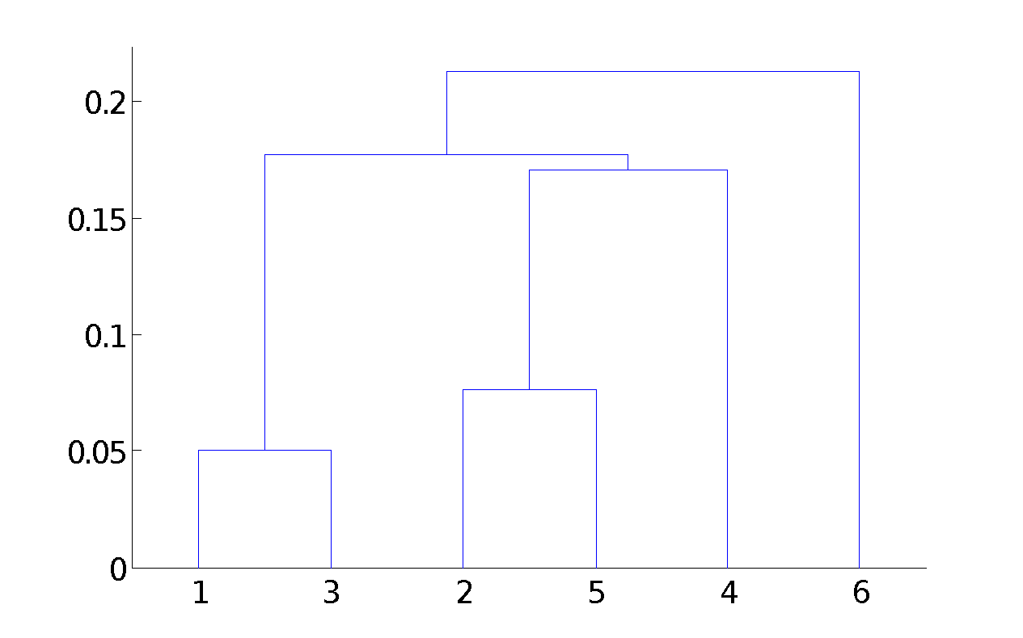
Hierarchical Clustering
Produces a set of nested clusters organized as a hierarchical tree
Can be visualized as a dendrogram
A tree like diagram that records the sequences of merges or splits

Slide 31
Strengths of Hierarchical Clustering
Do not have to assume any particular number of clusters
Any desired number of clusters can be obtained by ‘cutting’ the dendrogram at the proper level
They may correspond to meaningful taxonomies
Example in biological sciences (e.g., animal kingdom, phylogeny reconstruction, …)

Slide 32
Hierarchical Clustering
Two main types of hierarchical clustering
Agglomerative:
Start with the points as individual clusters
At each step, merge the closest pair of clusters until only one cluster (or k clusters) left
Divisive:
Start with one, all-inclusive cluster
At each step, split a cluster until each cluster contains an individual point (or there are k clusters)

Slide 33
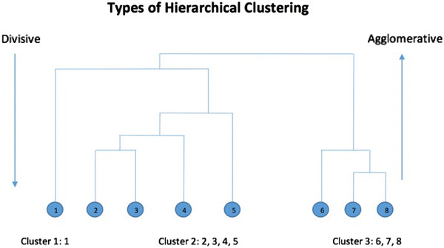
Hierarchical Clustering

Slide 34
Agglomerative Clustering Algorithm
Most popular hierarchical clustering technique
Basic algorithm is straightforward
Compute the proximity matrix
Let each data point be a cluster
Repeat
Merge the two closest clusters
Update the proximity matrix
Until only a single cluster remains
Key operation is the computation of the proximity of two clusters

Slide 35
How to Define Inter-Cluster Distance
p1
p2
p3
p4
p5
. . .
p1
Similarity?
p2
p3
p4
MIN
MAX
Group Average
Distance Between Centroids
p5
.
.
.
Proximity Matrix

Slide 36
How to Define Inter-Cluster Similarity
p1
p2
p3
p4
p5
. . .
p1
p2
p3
p4
MIN
MAX
Group Average
Distance Between Centroids
p5
.
.
.
Proximity Matrix

Slide 37
How to Define Inter-Cluster Similarity
p1
p2
p3
p4
p5
. . .
p1
p2
p3
p4
MIN
MAX
Group Average
Distance Between Centroids
p5
.
.
.
Proximity Matrix

Slide 38
How to Define Inter-Cluster Similarity
p1
p2
p3
p4
p5
. . .
p1
p2
p3
p4
MIN
MAX
Group Average
Distance Between Centroids
p5
.
.
.
Proximity Matrix

Slide 39
How to Define Inter-Cluster Similarity
p1
p2
p3
p4
p5
. . .
p1
×
×
p2
p3
p4
MIN
MAX
Group Average
Distance Between Centroids
p5
.
.
.
Proximity Matrix

Slide 40
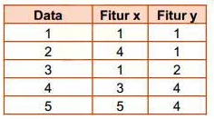
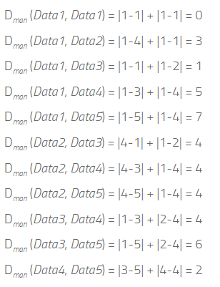
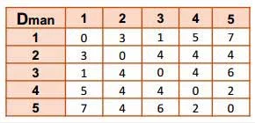
Contoh Hierarchical Clustering

Slide 41
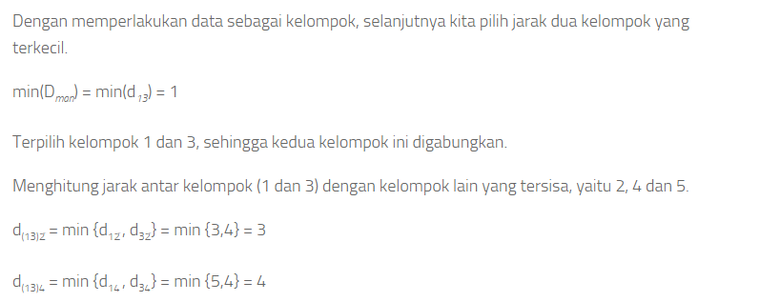
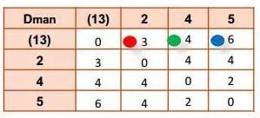
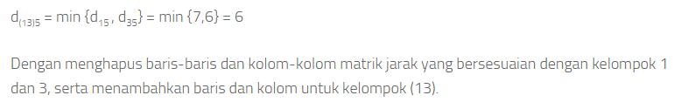
Contoh

Slide 42
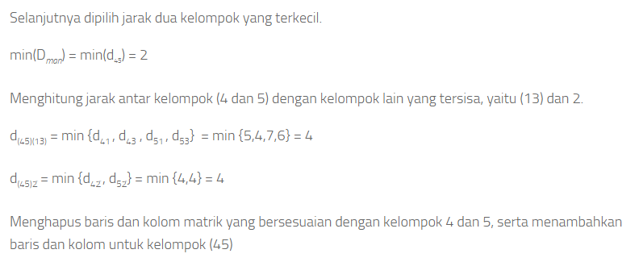
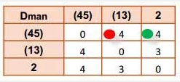
Contoh

Slide 43
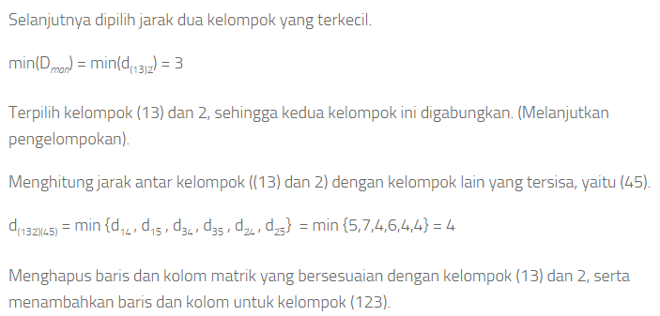
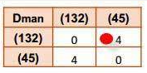
Contoh

Slide 44
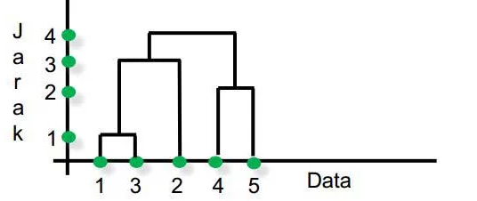
Contoh

Slide 45
Pros
No assumption of a particular number of clusters (i.e. k-means)
May correspond to meaningful taxonomies

Slide 46
Cons
Once a decision is made to combine two clusters, it can’t be undone
Too slow for large data sets

Slide 47
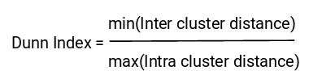
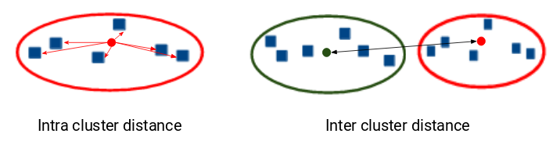
Evaluation Matrix
Inertia : inertia actually calculates the sum of distances of all the points within a cluster from the centroid of that cluster.
Dunn Index

Slide 48
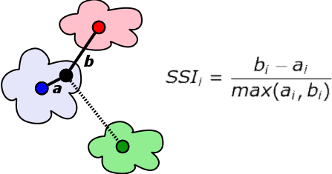
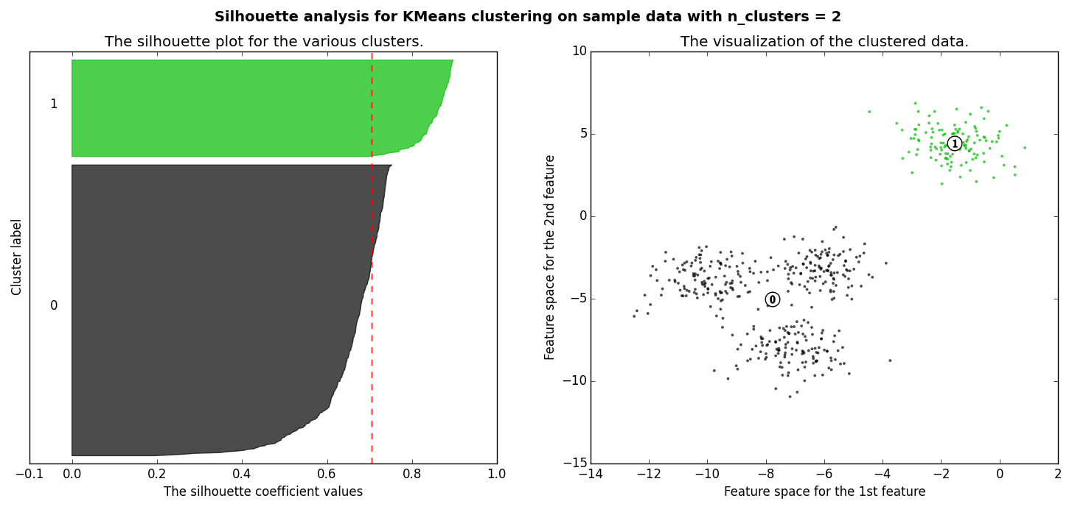
Evaluation Matrix
Silhouette score
Score = [-1,1] . +1 means a cluster is far away from its neighbor cluster
a= average intra-cluster distance
b= average inter-cluster distance

Slide 49
Thank You

